Slide 1
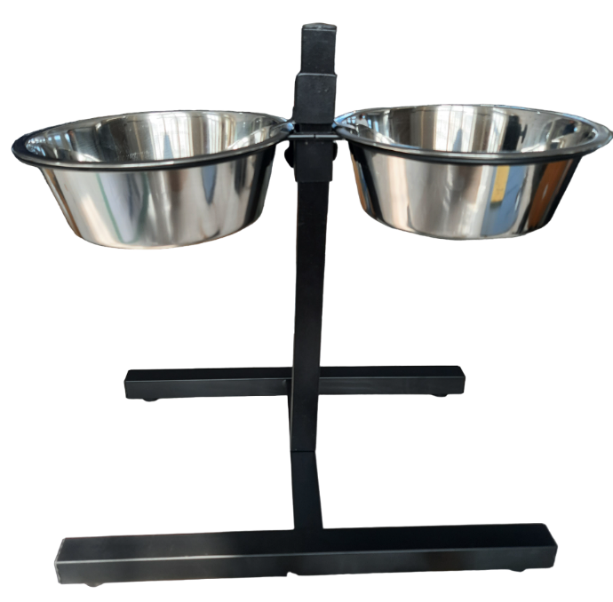
SWT 7000 – 1
LENGTH- 46.3 CM
HEIGHT-
41 CM
WIDTH-
27 CM

Slide 2
SWT 7000 – 2
LENGTH- 53.5 CM
HEIGHT-
41 CM
WIDTH-
27 CM

Slide 3
SWT 7000 – 3
LENGTH- 59 CM
HEIGHT-
41 CM
WIDTH-
27 CM

