Slide 1
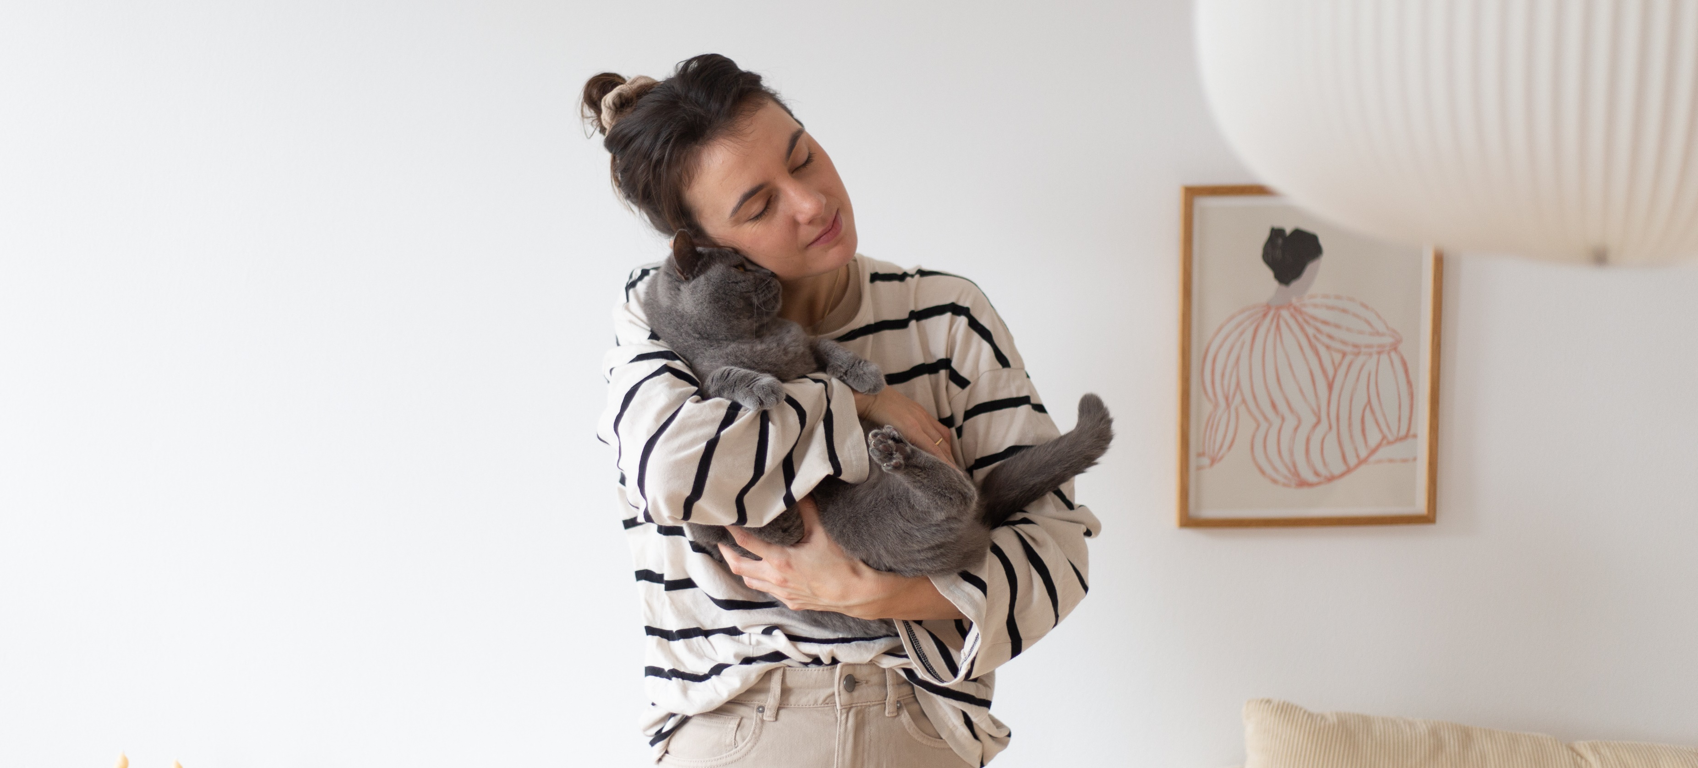

GimCat Design Relaunch

Slide 2
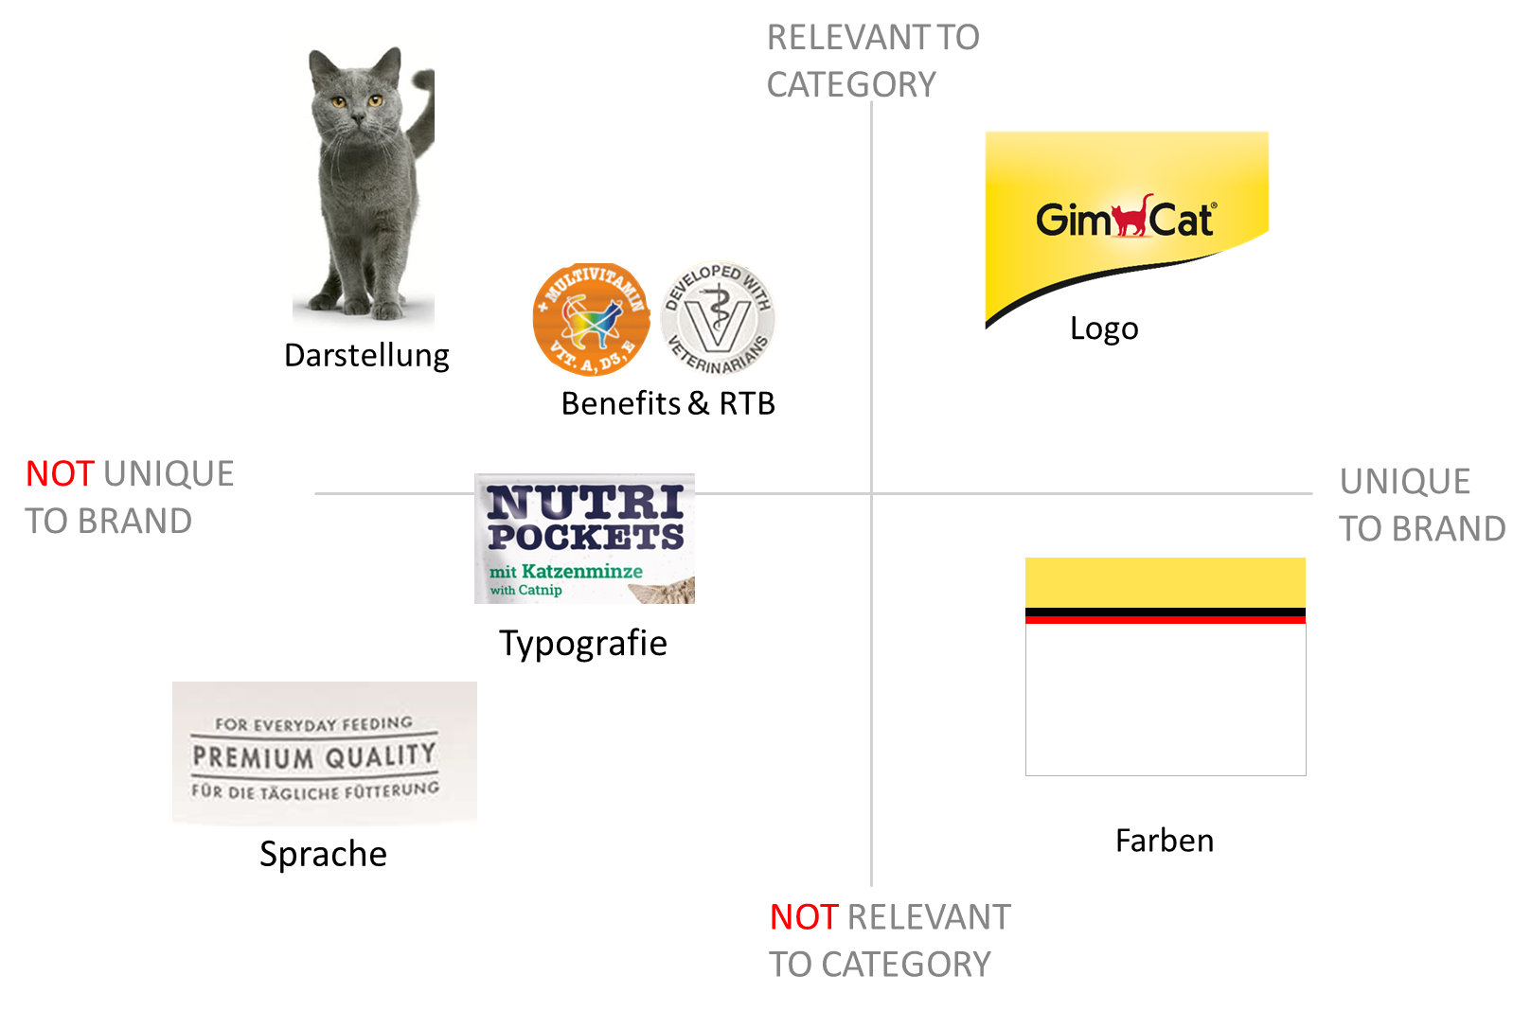
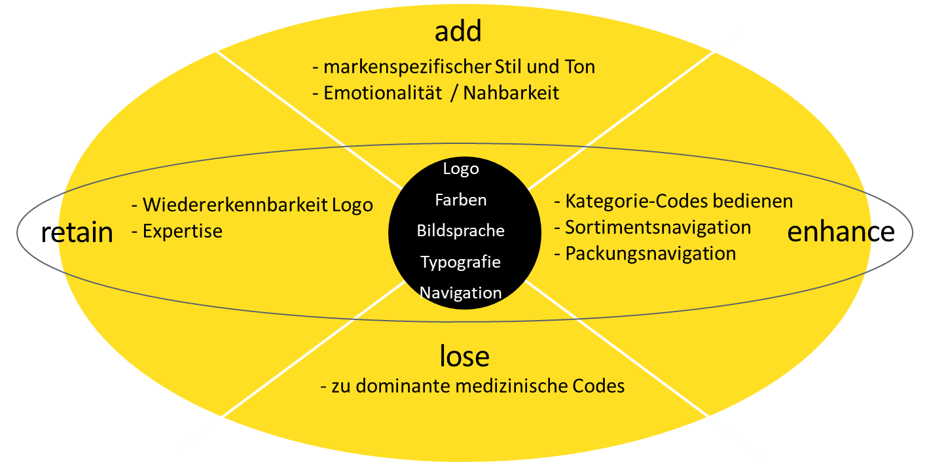
Goals: Designrelaunch
Strengthening the categories impulse, indulgence, emotionality
Designing unique (category-relevant) packaging elements and creating better navigation
Enrich strong brand bracket and expertise with emotion and approachability and thus serve category codes
Increase GimCat's brand relevance in all segments and differentiate it more strongly from the competition

Slide 3
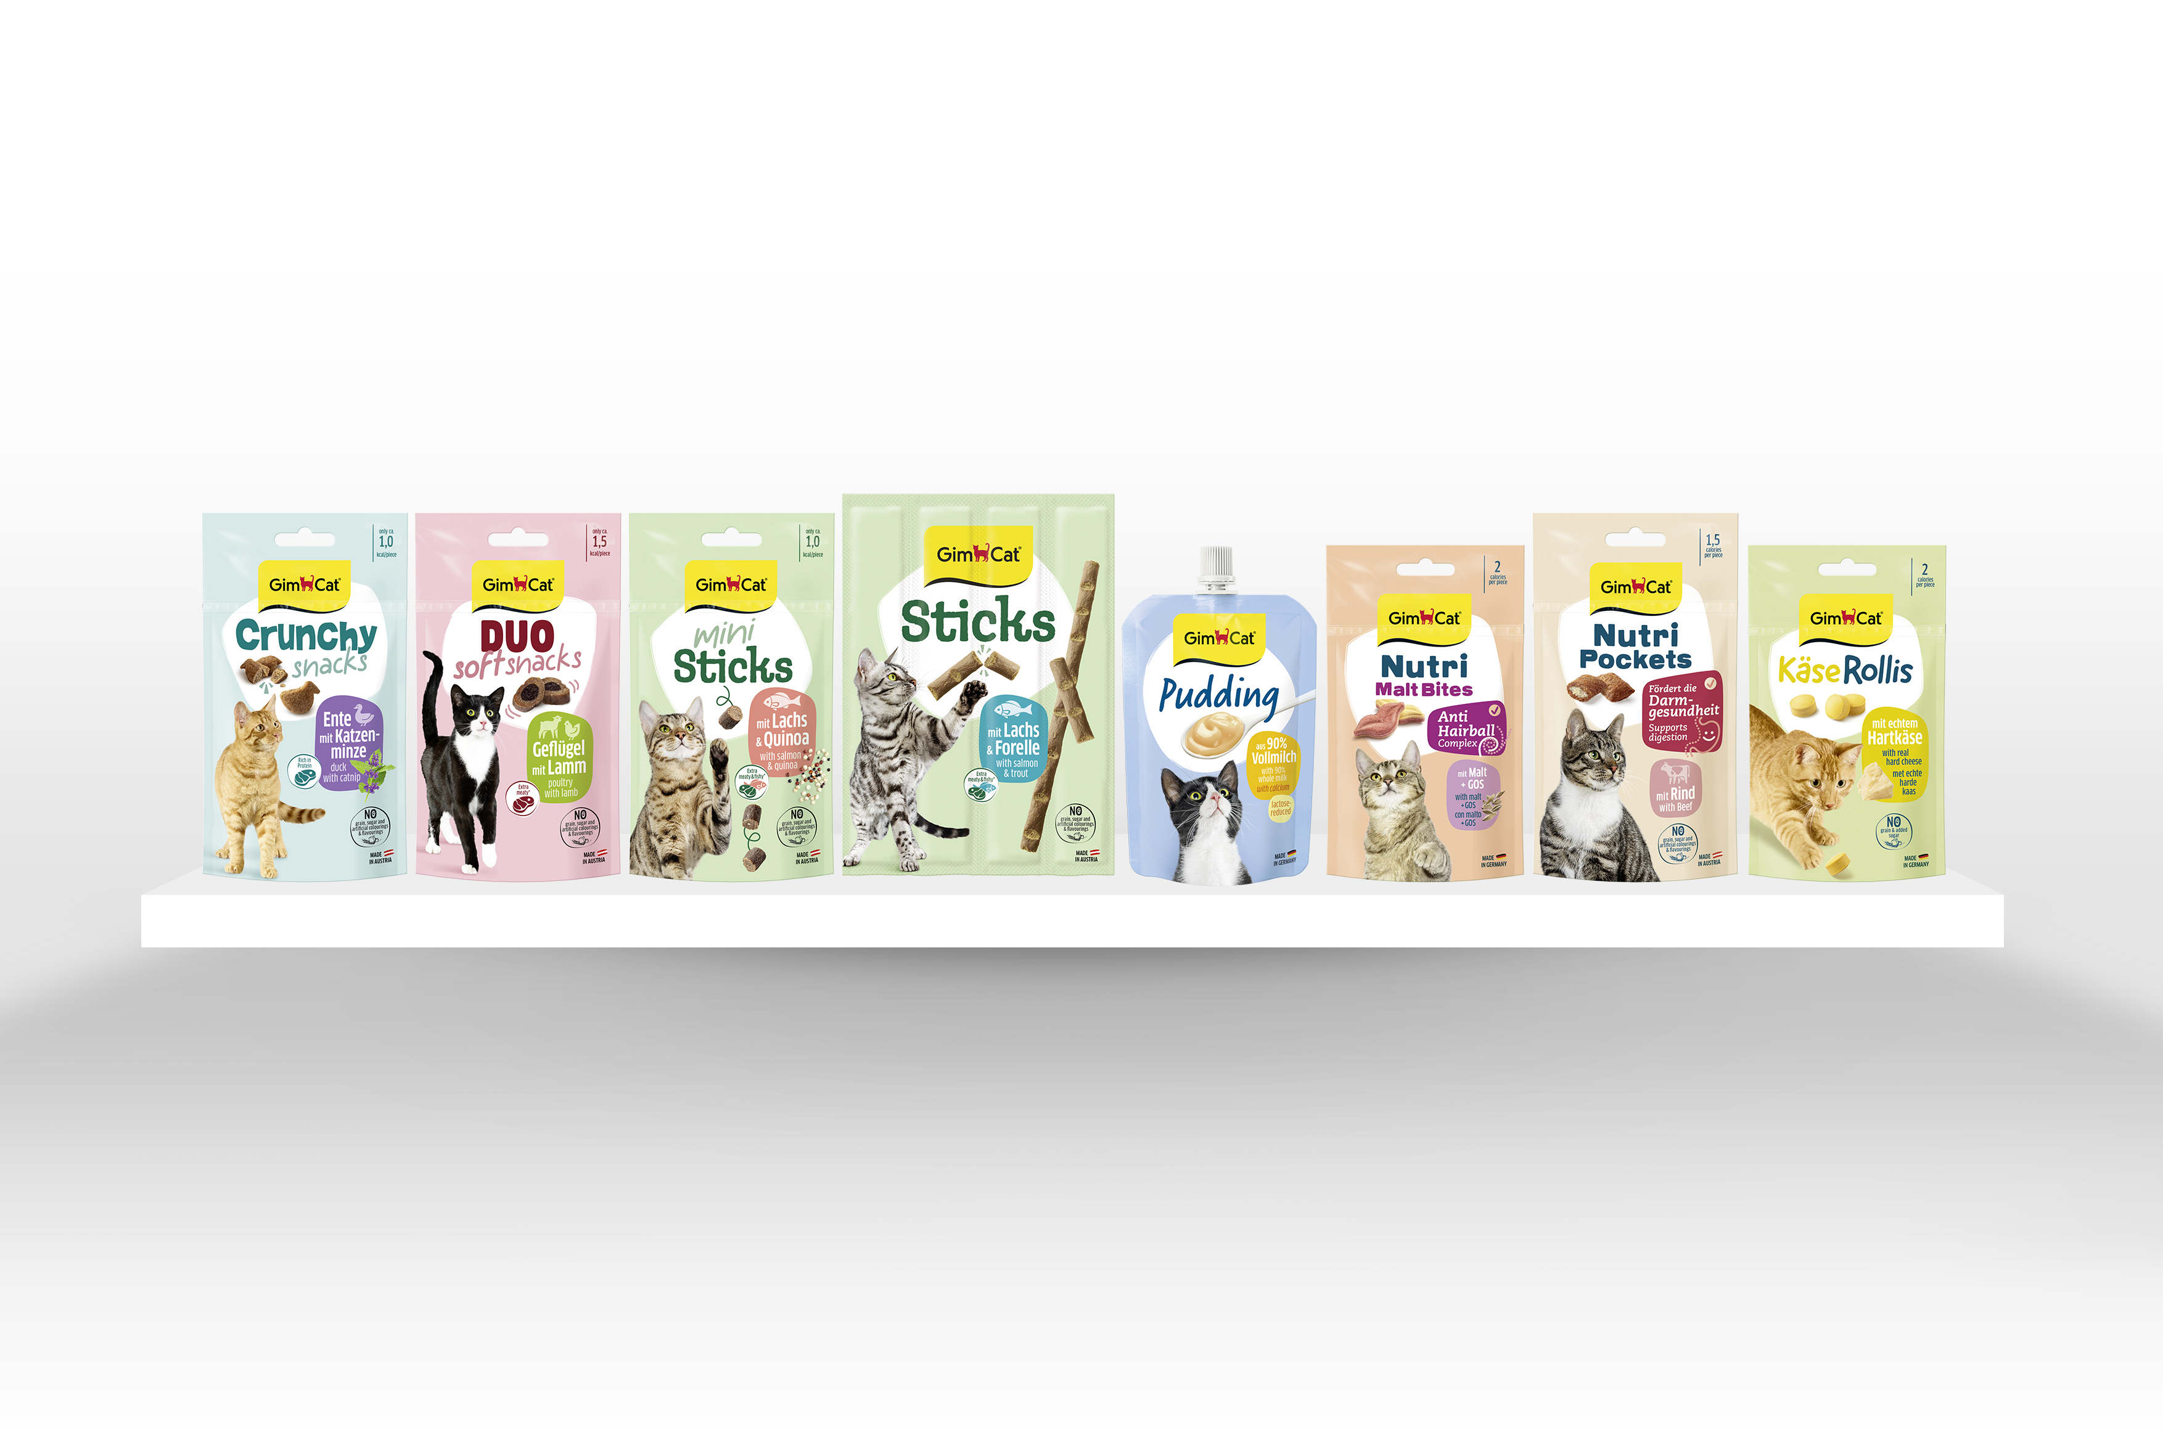
Our new Snack-Design
With the trend: strong colours attract attention & convey emotionality
Segment-typical attributes such as emotionality, impulse, fun & pampering are significantly strengthened
Genuine, high-quality & own cat & product images emphasise the individuality & premium character of the GimCat brand

Slide 4
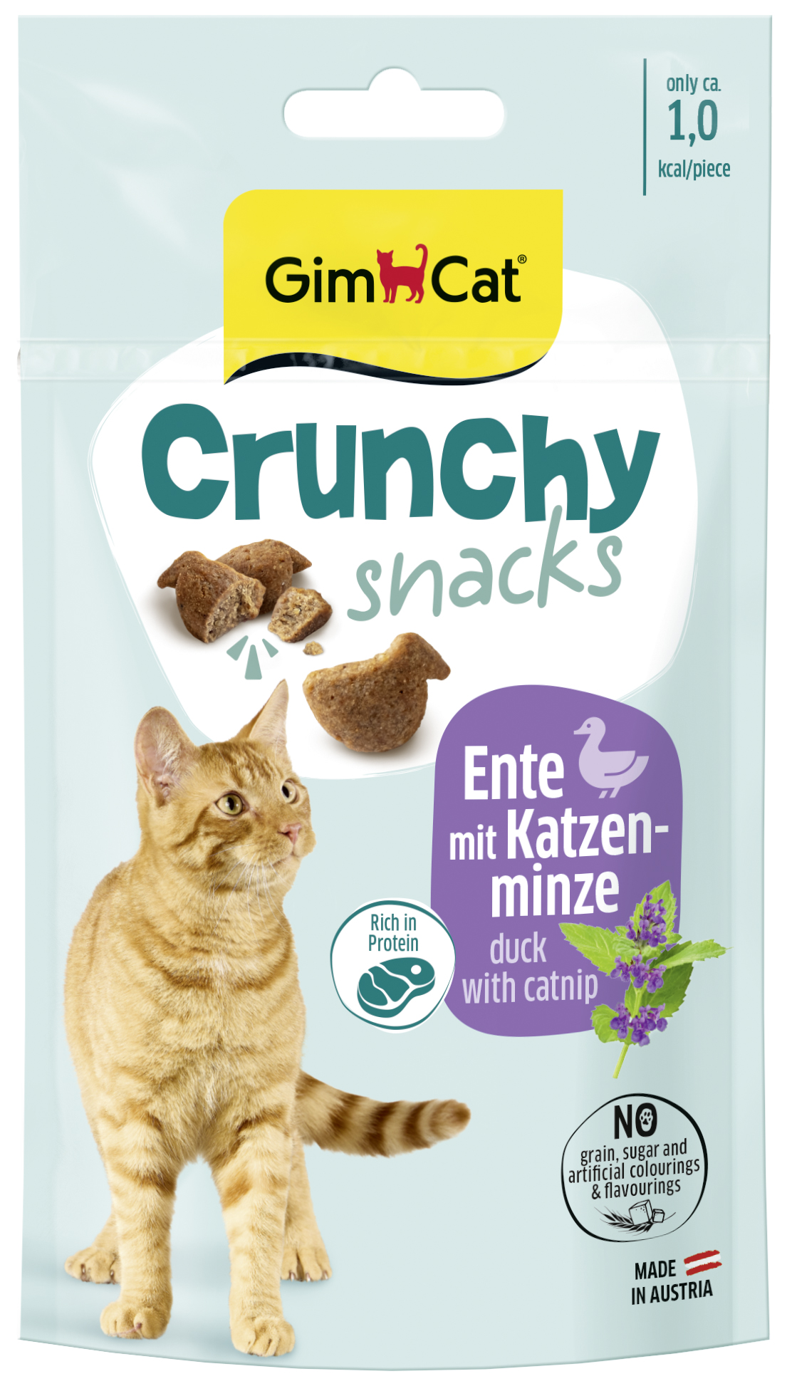
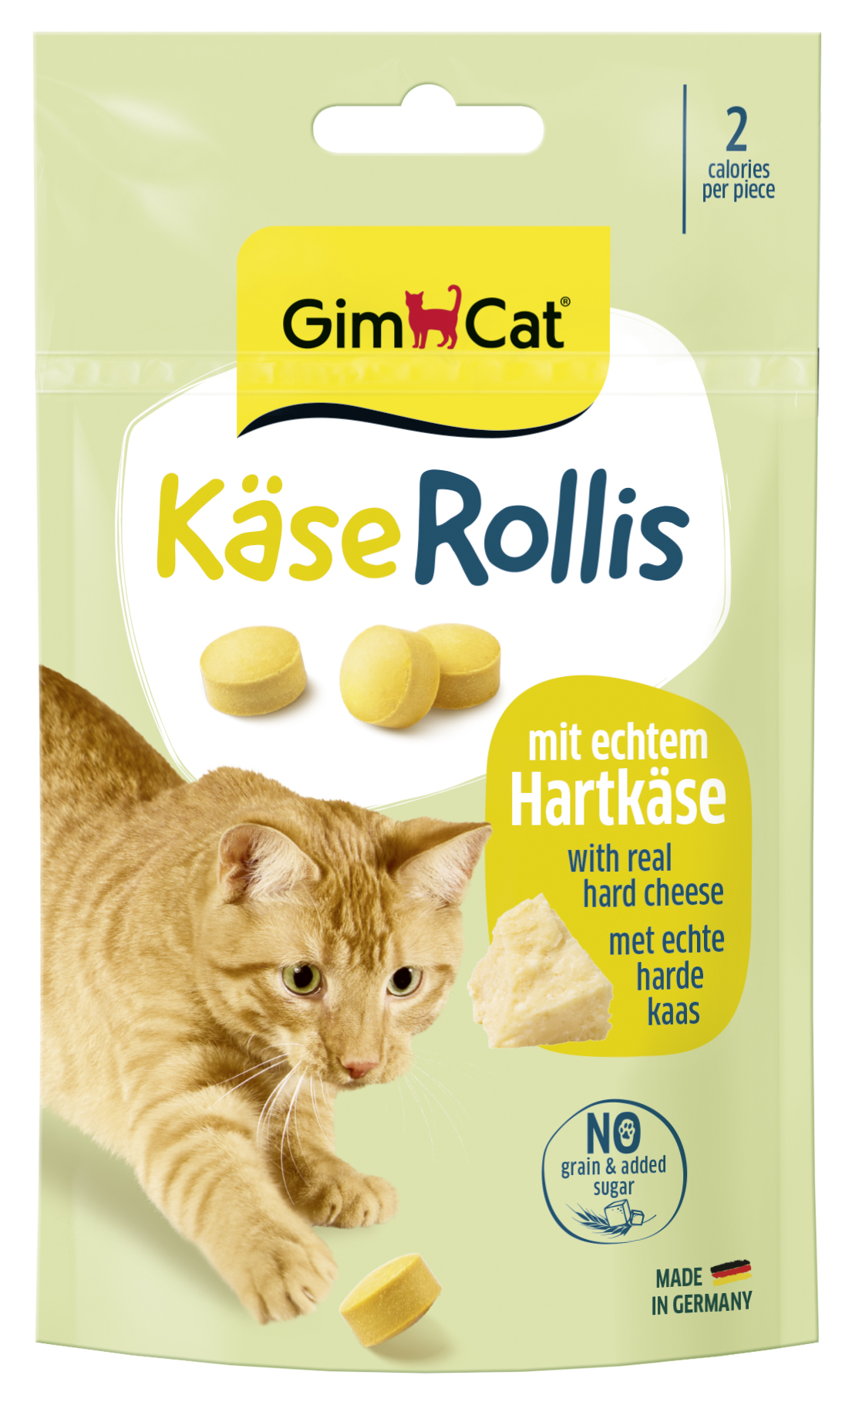
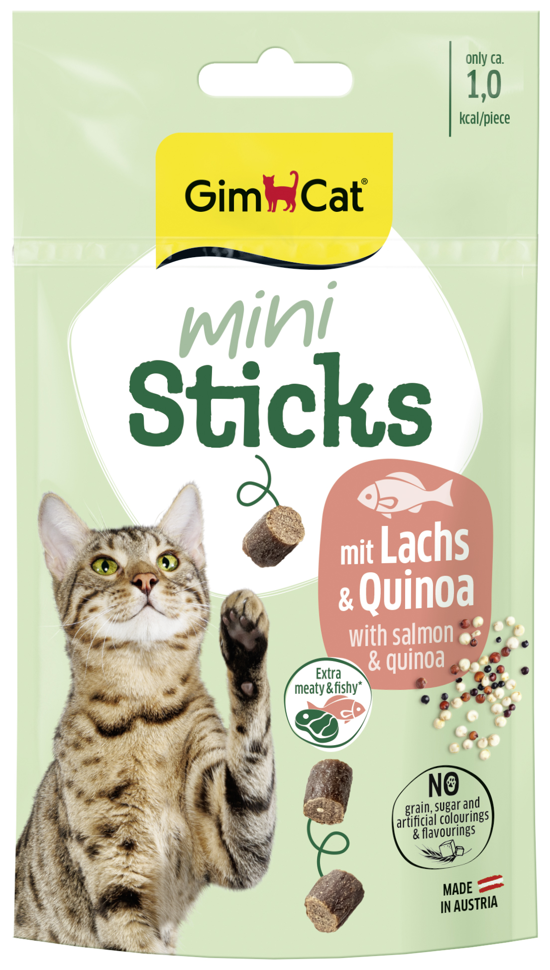
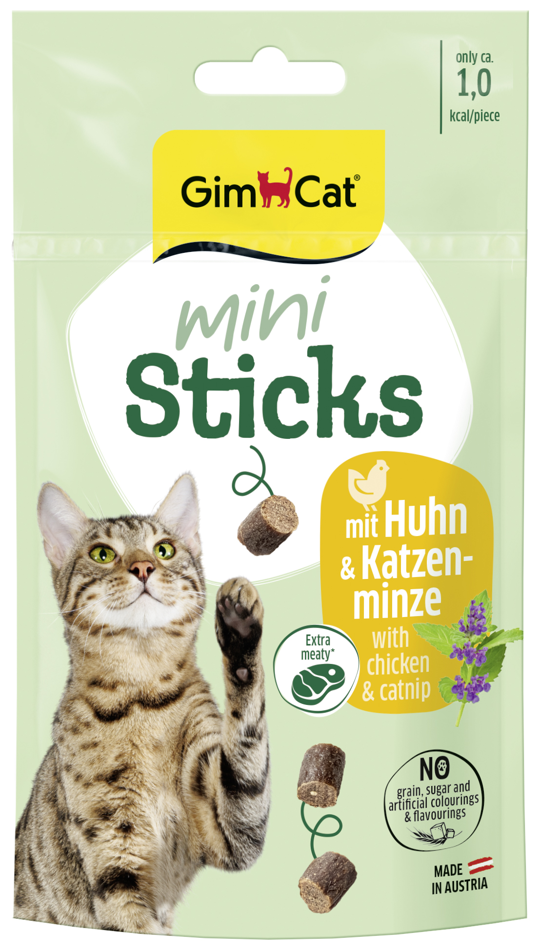
New Design: Elements
Segment-specific colour
Umbrella Brand
Contrast with background colours brings the logo into focus & creates high recognisability
Creates emotionality, clear navigation of the segment
Field of the sub-brand (+ product image)
Variety
Forms a strong brand bracket, fonts create product identities & emotionality
Strong colours for clear coding & navigation
Cat pictures
Benefits
Specially shot, high-quality cats in motion emphasise the individuality of the brand and segments and underline the premium character
Relevant & structured
The consistent use of design elements creates a brand typology and a brand image!

Slide 5
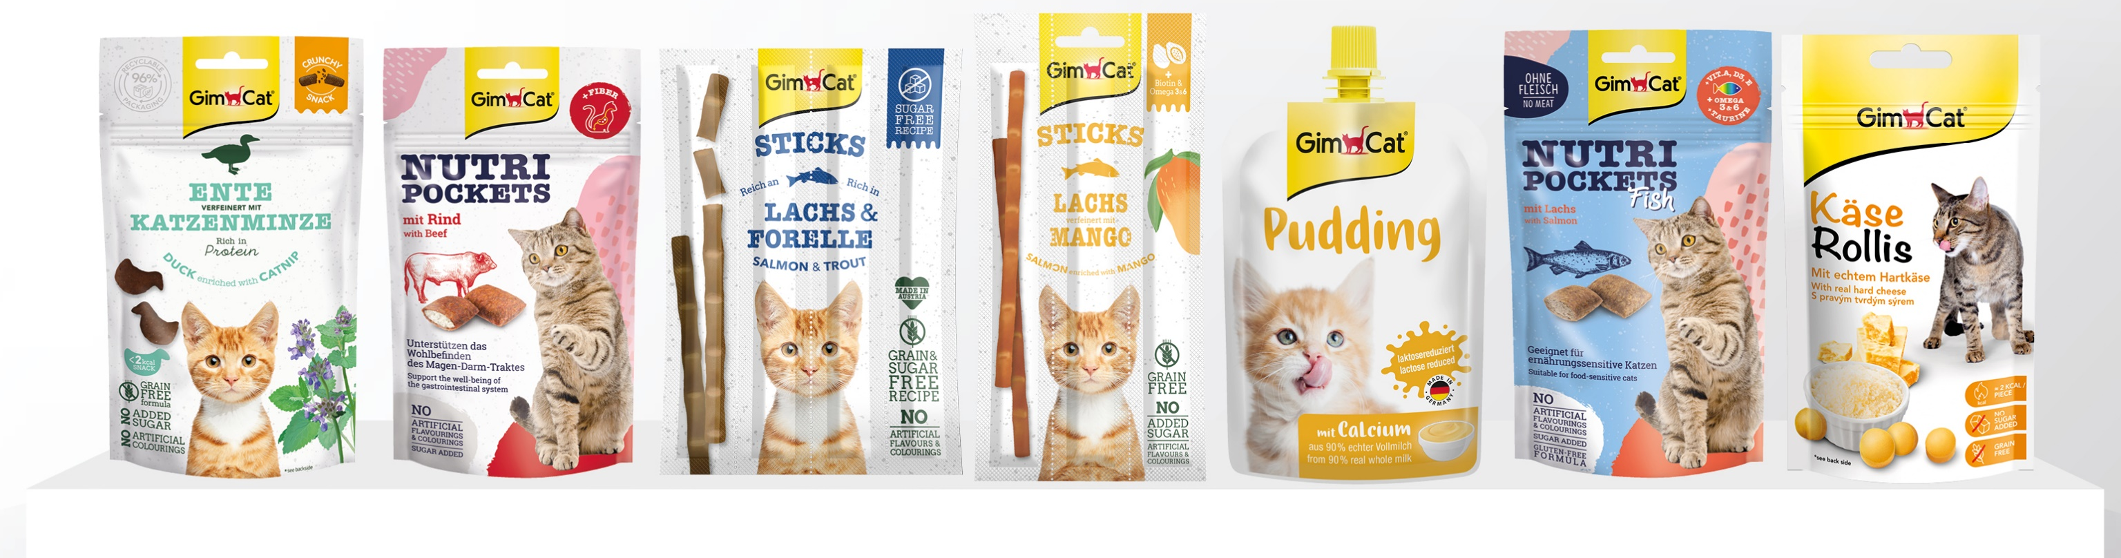
Feedback & Diskussion

Slide 6
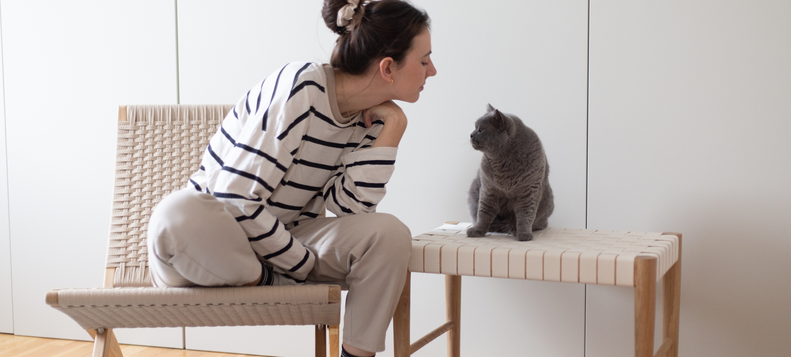

Stand Juni 2023
^{H. von Gimborn GmbH}
^{Albert-Einstein-Straße 6}
^{46446 Emmerich am Rhein}
^{Tel. +49 (0) 2822-964-0}

